Slide 1

Week 1 Effective Reading and Note-Taking strategies
Fall 2023

Slide 2

Lead-in
Paragraph structure
Note-Taking Methods
Practice

Slide 3

Lead-in
What kind of reading do you prefer? Why?
What is the difference between reading efficiently and effectively?
What reading skills/strategies do you usually use? Why?

Slide 4
Paragraph structure

Slide 5
What is a Paragraph?
is a group of sentences about a single topic
explains the writer’s main idea about the topic

Slide 6
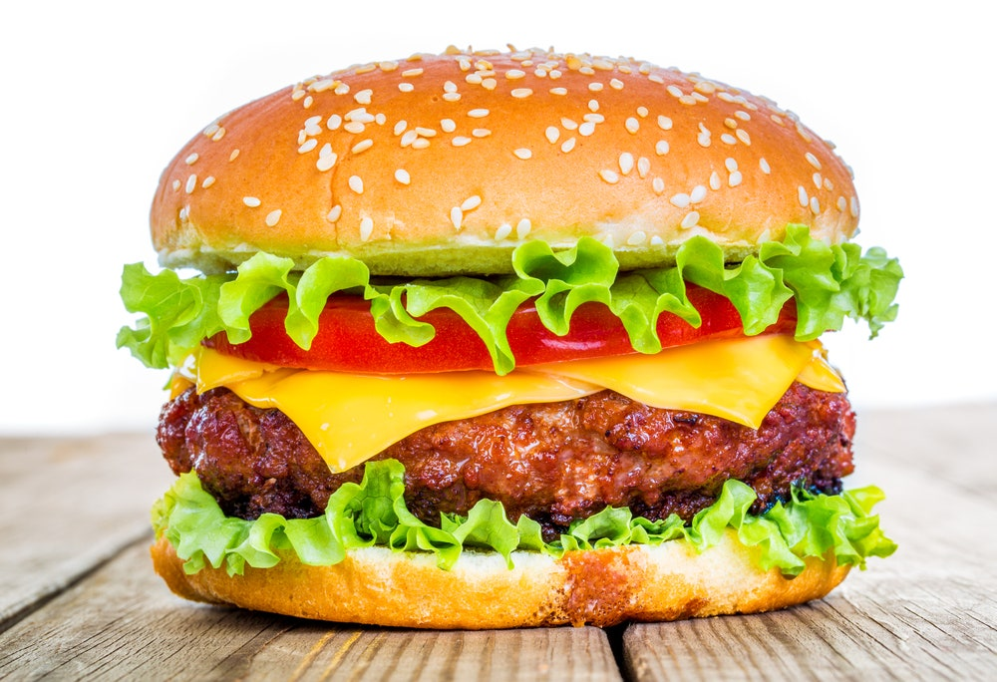
Basic Paragraph Structure
Topic Sentence (Main Idea)
Major Supporting Point
Minor Supporting detail
Major Supporting Point
Minor Supporting detail
Major Supporting Point
Minor Supporting detail
Concluding Sentence
(Restate the main idea)
Grab the audience
attention
3-4 key points
Key message

Slide 7
Switzerland – something interesting at every turn By Ken Jones
If you dream of travelling to a country with beautiful mountains, wonderful places to go sightseeing and polite people, you should visit Switzerland. If you look at the map, the first thing you notice is that Switzerland has many mountains, including some of the highest in Europe. Climbing or skiing down the mountains is great fun. Another thing you will notice is that Switzerland shares its borders with five different countries: France, Germany, Italy, Austria and Liechtenstein. In fact, there are four official languages in Switzerland: German, French, Italian and Romansch. All these groups of people make Swiss culture very interesting. Finally, Switzerland has many cities and interesting places to visit. Cities such as Bern have modern buildings like the Paul Klee Zentrum, yet the traditional alpine refuges in the mountains show that the country’s old traditions are still alive. All the people, places and things to see definitely make Switzerland a great place for a holiday.
What is the topic of the paragraph?
What is the main idea about the topic?
What ideas help explain the main idea?
Source: Zemach, D.E., & Rumisek, L.A. (2005). Academic Writing

Slide 8
Switzerland – something interesting at every turn By Ken Jones If you dream of travelling to a country with beautiful mountains, wonderful places to go sightseeing and polite people, you should visit Switzerland. If you look at the map, the first thing you notice is that Switzerland has many mountains, including some of the highest in Europe. Climbing or skiing down the mountains is great fun. Another thing you will notice is that Switzerland shares its borders with five different countries: France, Germany, Italy, Austria and Liechtenstein. In fact, there are four official languages in Switzerland: German, French, Italian and Romansch. All these groups of people make Swiss culture very interesting. Finally, Switzerland has many cities and interesting places to visit. Cities such as Bern have modern buildings like the Paul Klee Zentrum, yet the traditional alpine refuges in the mountains show that the country’s old traditions are still alive. All the people, places and things to see definitely make Switzerland a great place for a holiday.
The topic sentence
The supporting sentences
The concluding sentence

Slide 9
Note Taking Methods

Slide 10
Common note-taking methods
1. The Outlining Method
2. The Mapping Method
3. The Charting Method

Slide 11
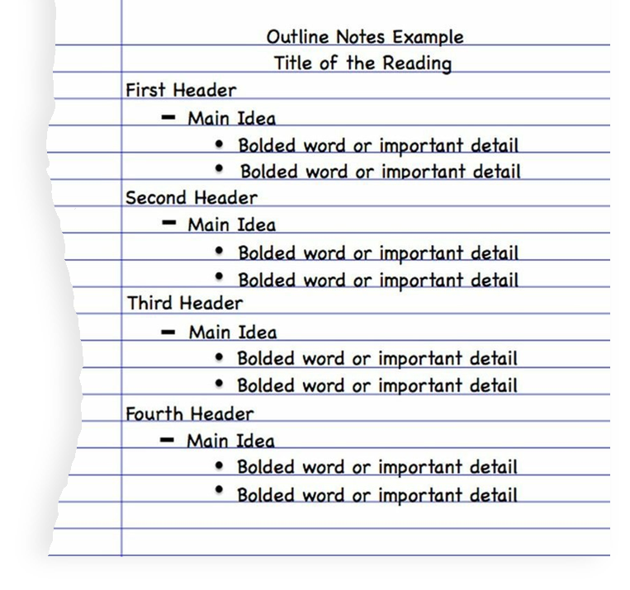
The Outlining Method

Slide 12
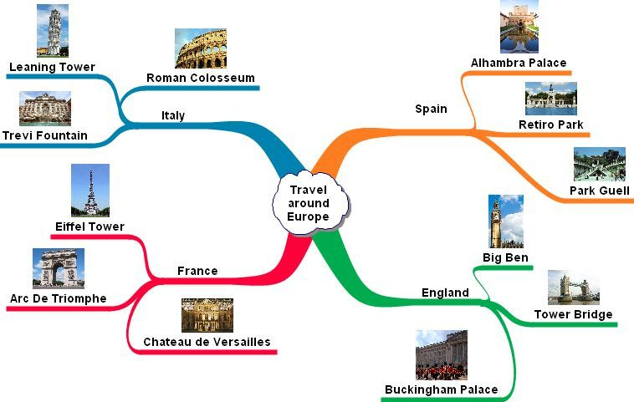
The Mapping Method

Slide 13
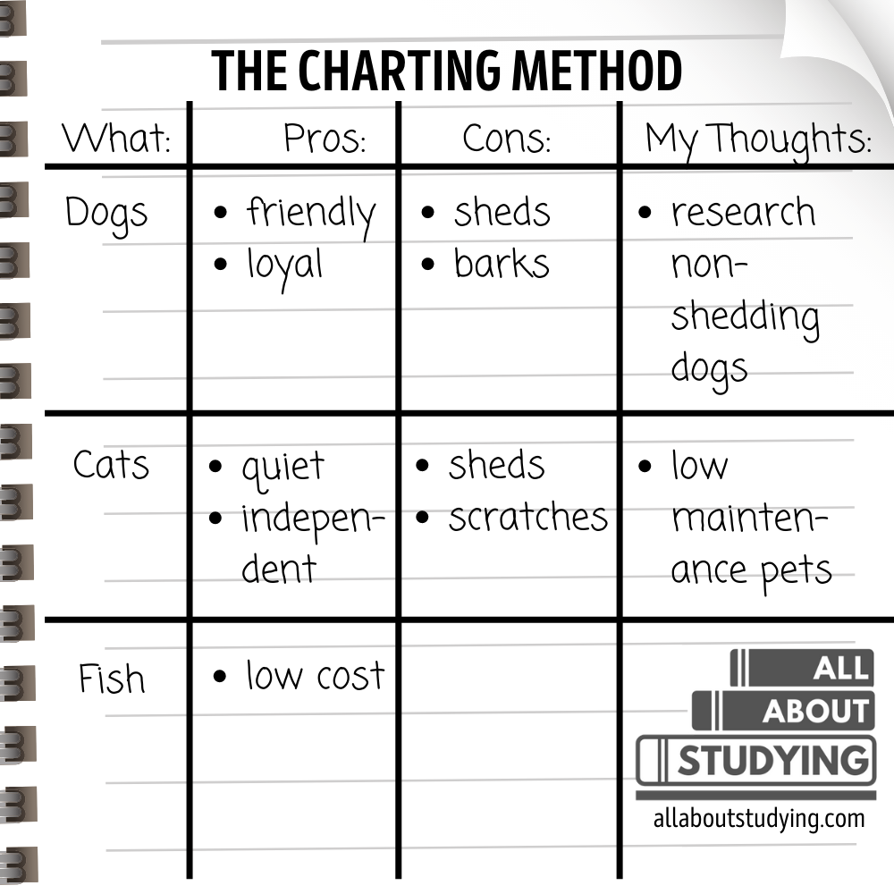

Slide 14
PRACTICE

Slide 15
Switzerland – something interesting at every turn By Ken Jones If you dream of travelling to a country with beautiful mountains, wonderful places to go sightseeing and polite people, you should visit Switzerland. If you look at the map, the first thing you notice is that Switzerland has many mountains, including some of the highest in Europe. Climbing or skiing down the mountains is great fun. Another thing you will notice is that Switzerland shares its borders with five different countries: France, Germany, Italy, Austria and Liechtenstein. In fact, there are four official languages in Switzerland: German, French, Italian and Romansch. All these groups of people make Swiss culture very interesting. Finally, Switzerland has many cities and interesting places to visit. Cities such as Bern have modern buildings like the Paul Klee Zentrum, yet the traditional alpine refuges in the mountains show that the country’s old traditions are still alive. All the people, places and things to see definitely make Switzerland a great place for a holiday.
The topic sentence
The supporting sentences
The concluding sentence

Slide 16
ACTIVITY 1: Make an outline
I. Topic Sentence (Main Idea):
A. Major Supporting Point 1:
1. Minor Supporting detail:
B. Major Supporting Point 2:
1. Minor Supporting detail:
2. Minor Supporting detail:
C. Major Supporting Point 3:
1. Minor Supporting detail:
Concluding Sentence:
(Restate the main idea)

Slide 17
Suggested answer:
I. You should visit Switzerland
A. Many mountains
1. climbing and skiing down=fun
B. Borders with 5 countries
1. 4 official languages
2. interesting culture
C. Interesting places
1. modern and old places
Switzerland is perfect for holiday

Slide 18
ACTIVITY 2: The Mapping Methods
Classes in literature are useful no matter what job you intend to have when you finish university. People who study literature learn the skill of reading carefully and understanding characters, situations, and relationships. This kind of understanding can be useful to teachers and business-people alike. Literature classes also require a lot of writing, so they help students develop the skill of clear communication. Of course, a professional writer needs to have this skill, but it is an equally important skill for an engineer. Finally, reading literature helps develop an understanding of many different points of view. Reading a novel by a Russian author, for example, will help a reader learn more about Russian culture. For anyone whose job may bring them into contact with Russian colleagues, this insight can help encourage better cross-cultural understanding.
Source: Zemach, D.E., & Rumisek, L.A. (2005). Academic Writing

Slide 19
Literature classes are useful for all students
learn reading carefully & understanding
develop writing = clear communication
understand many points of view
good for teachers & business ppl
useful for writer and engineer
reading Russian novels = understanding Russian culture
better cross cultural understanding

Slide 20
California Weather
Springtime in California means sunny days with comfortable temperatures. The mild temperatures are perfect for outdoor activities and fun. Overcast skies and an occasional drizzle might occur, but for the most part, days are enjoyable. Most people like the endless summer atmosphere of California. Scorching hot days with nonstop sun mean fun on the beach, surfing and swimming. The lack of humidity means that although it is hot, it is not unbearable. Fall and winter may bring cooler temperatures, some rain, and usually gusty winds in the mountain passes. But winter also brings snow, and snow in the mountains means wintertime fun during day trips to the mountains with a return to warmer temperatures off the mountain slopes. There are many different types of weather in California, but almost all types mean enjoyment.

Slide 21
Question 1
Where is the main idea of this paragraph?
in the first sentence
in the second sentence
in the third sentence
in the fourth sentence
in the last sentence

Slide 22
Question 2
Which of the following statements best states the main idea of the paragraph?
California is a good place to live.
People who live in California are very lucky.
California has very nice temperatures in the springtime.
When people come to California, they will notice that there is no humidity.
People can do many fun things because of California’s good weather.

Slide 23
Question 3
What is the best meaning for the word unbearable as it is used in the paragraph?
a large animal
unable to stand
major
mild
unable to enjoy

Slide 24
Question 4
What is the best meaning of the word slopes as it is used in the paragraph?
hills
stones
freeways
slides
roads

Slide 25
Question 5
What can you infer about people who live in California?
They like cold weather.
Californians are active in many types of weather.
They don't care what the weather is like.
People in California hate snow.
California always has the same weather.

Slide 26

Any questions?
You can find me at:
a.akhmedjanov@centralasian.uz
Office hours: by appointment
Office № 201

Slide 27
References
Zemach, D.E., & Rumisek, L.A. (2005). Academic Writing: From Paragraph to Essay. 3ed. Macmillan Publishers

